Slide 2
Managing Conflict
Among Team Guyana Robotics Members

Slide 3
Introduction
Conflict is a natural part of any team as people have different ideas, needs and perspectives.
When resolved properly, conflict can help teams grow, uncover better solutions and strengthen relationships.
Brainstorm examples of positive and negative conflict you have experienced.
Learning effective conflict resolution skills will help school teams and future careers.

Slide 4
Listen First
Listening is the most important skill because it shows respect and helps deescalate emotions.
Show 2-3 minutes of video which illustrates how open-ended questions help us listen to understand others.
Practice active listening skills by turning to a partner and taking turns sharing an example conflict, while the other listens without interruption. (Now listeners summarize back what you heard)

Slide 5
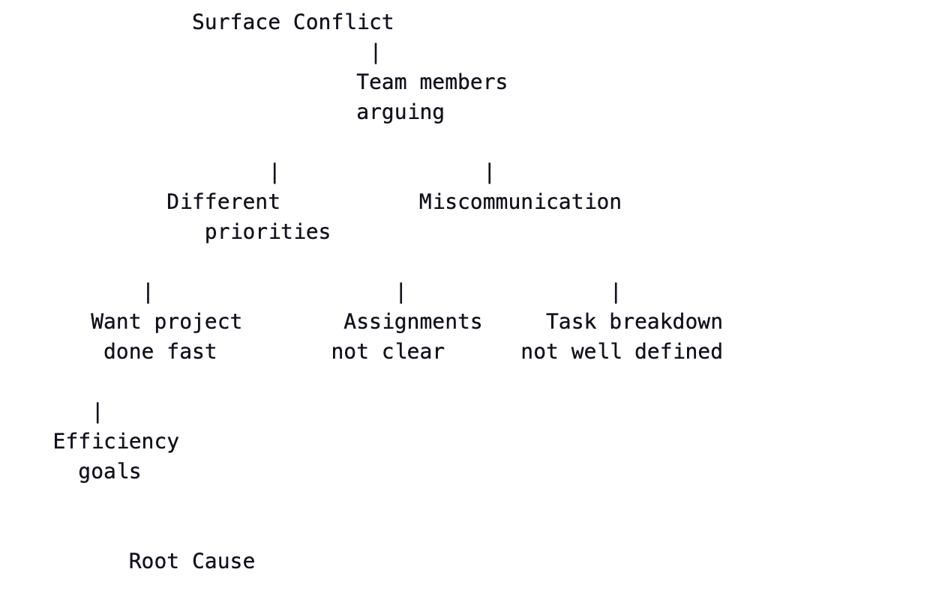
Uncover the Root Cause
•3 main causes of workplace/team conflict: different priorities, miscommunication, personality clashes.
•Share your own examples of each.
•Use a tree visualization to show how the surface conflict is just a symptom - the root cause lies deeper.
The tree shows how the surface-level conflict of team members arguing is a symptom originating from several root causes like having different priorities, miscommunication issues, and lack of clarity around assignments.
The different priorities branch illustrates one possible root cause: team members may have different goals, like one member wanting the project done fast to an efficiency goal while others have different priorities.
The miscommunication and task breakdown branches show two possible communication-based root causes: assignments not being clear or the delegation of tasks not being well-defined among team members.

Slide 6
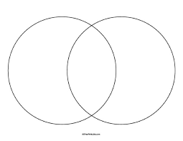
Focus on Interests
Find common interests
•Positions are our stated demands while interests are the underlying needs and goals.
•Venn diagram represents conflicting parties. Where circles overlap is shared interests - the common ground is on-time delivery & cost-effectiveness.
•Practice identifying interests behind opposing positions on an issue they're familiar with.
. Efficiency
. Flexibility
. Quality Work
. On-time delivery
. Cost effectiveness
. Innovation

